Slide 1

Auction System
Group 3
Sena Tarpan
Peter Hoesch
Yun Ye
February, 2023

Slide 2

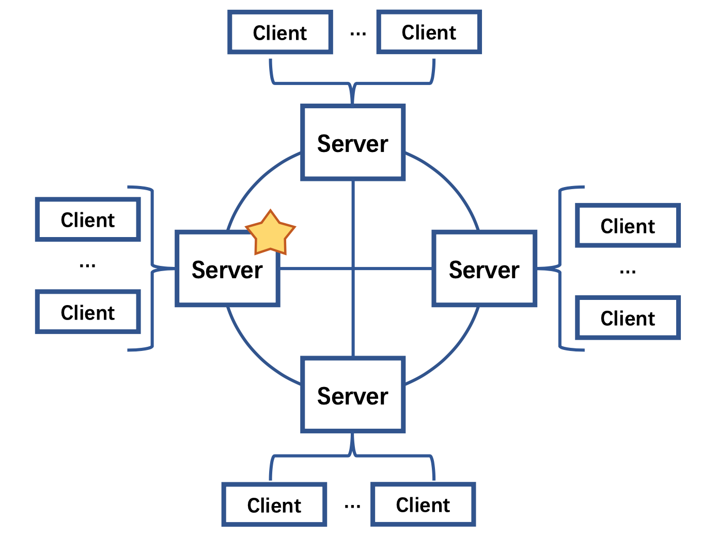
System Architecture
multi-server multi-client
main server and supplementary servers
UDP connection between clients and servers

Slide 3


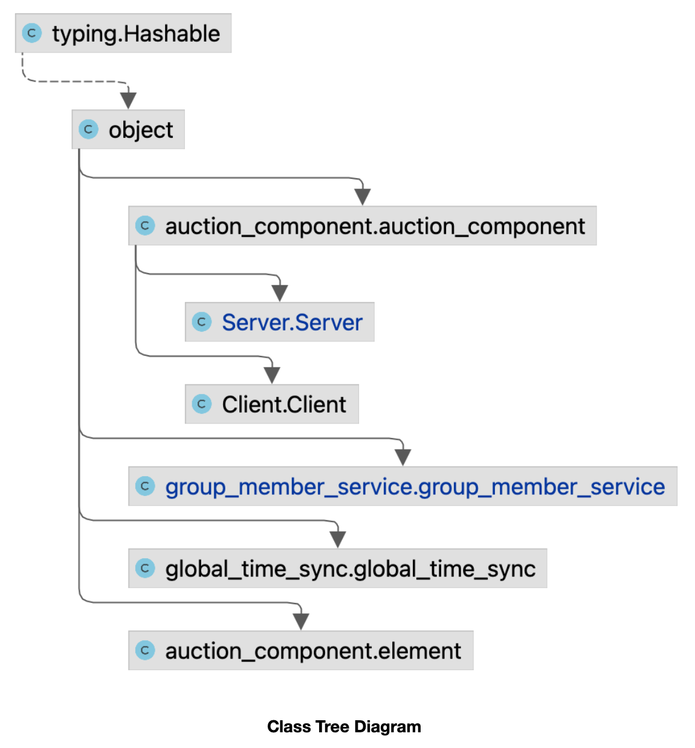
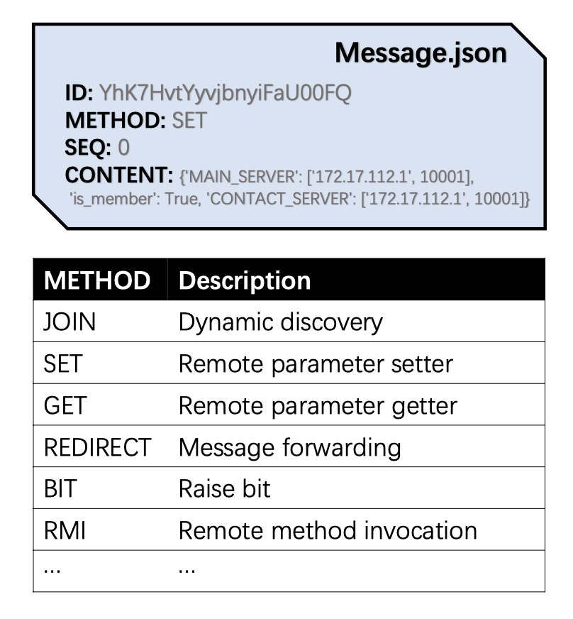
Implementation

Slide 4

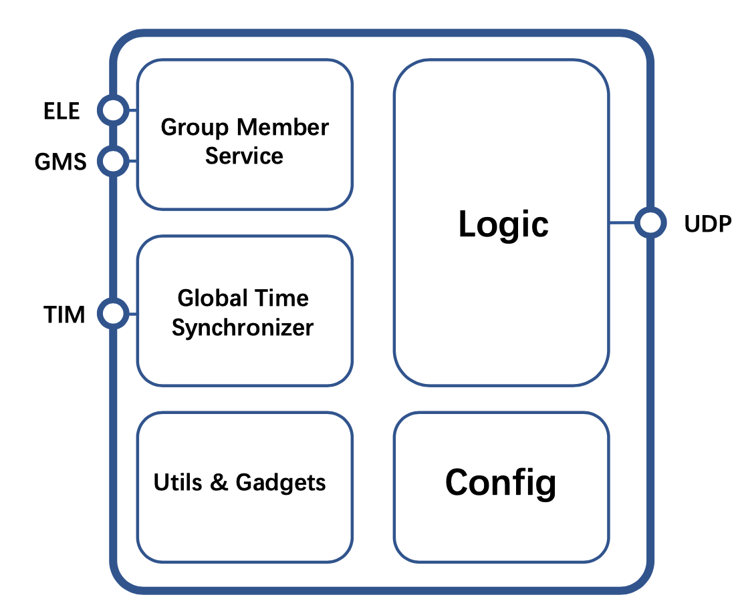
Implementation
Group Member Service
Global Time Sync

Slide 5

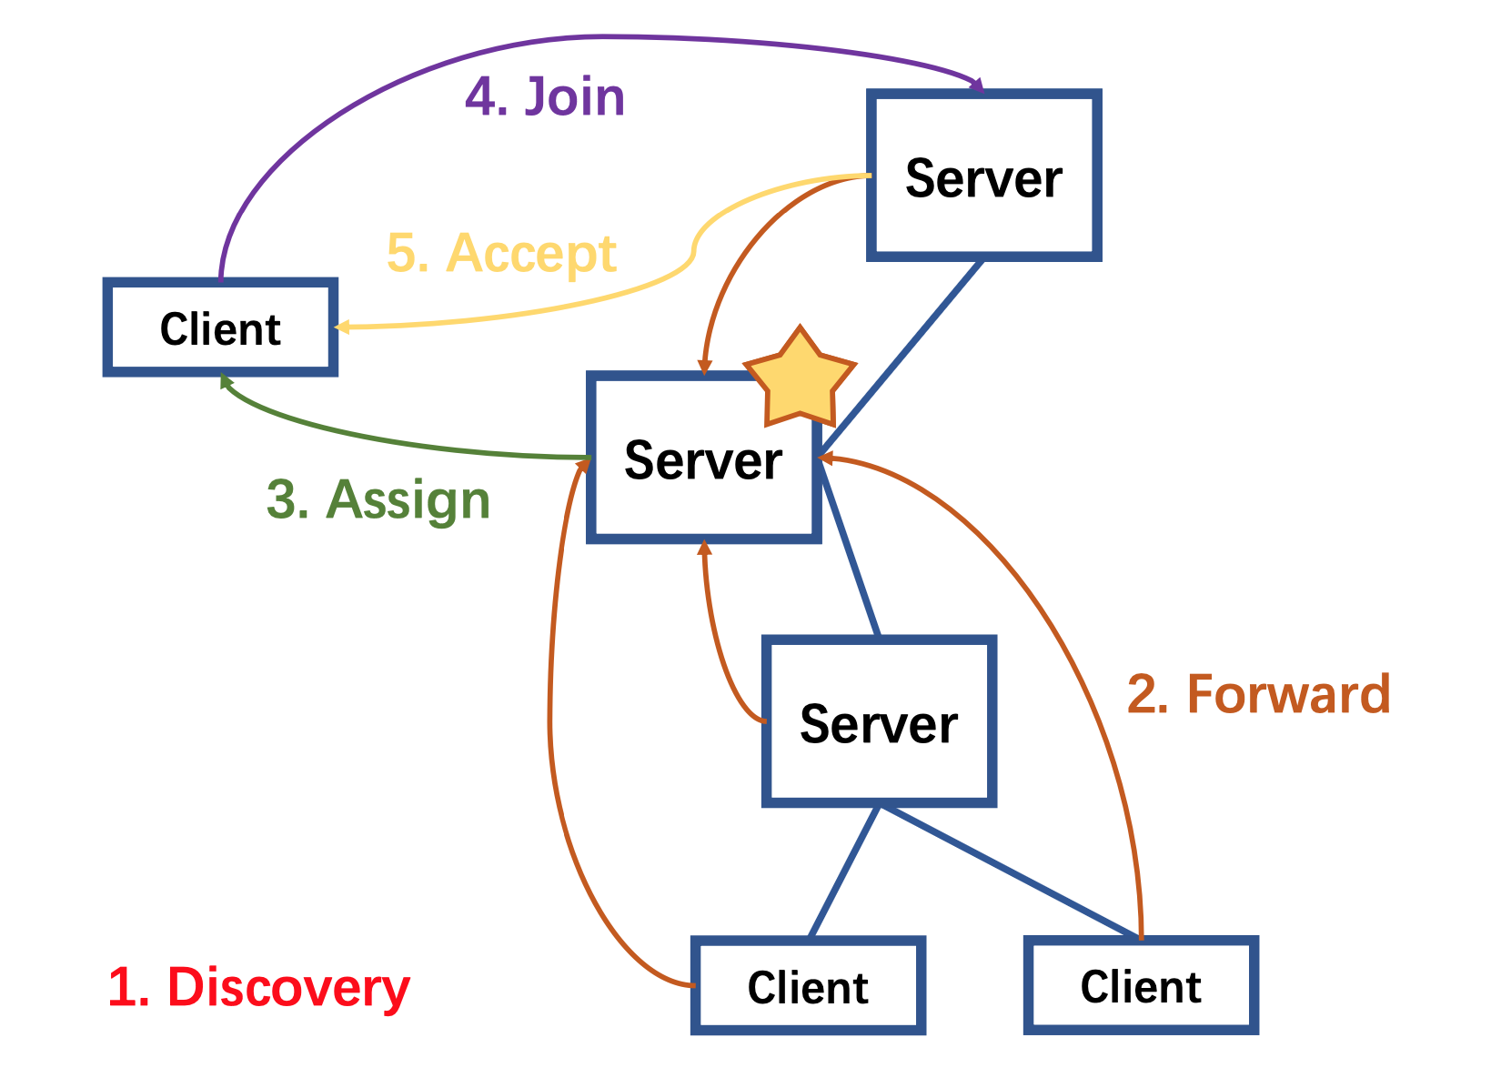
Dynamic Discovery
Broadcast

Slide 6
Fault tolerance
Heartbeat signal
Voting
Ring structure
The LaLann-Chang-Roberts algorithm
Ordered reliable multicast
Server use UDP with totally ordered reliable multicast

Slide 7


Demostration

Slide 8

Q & A

Slide 9

Thanks for attention!

